Slide 1
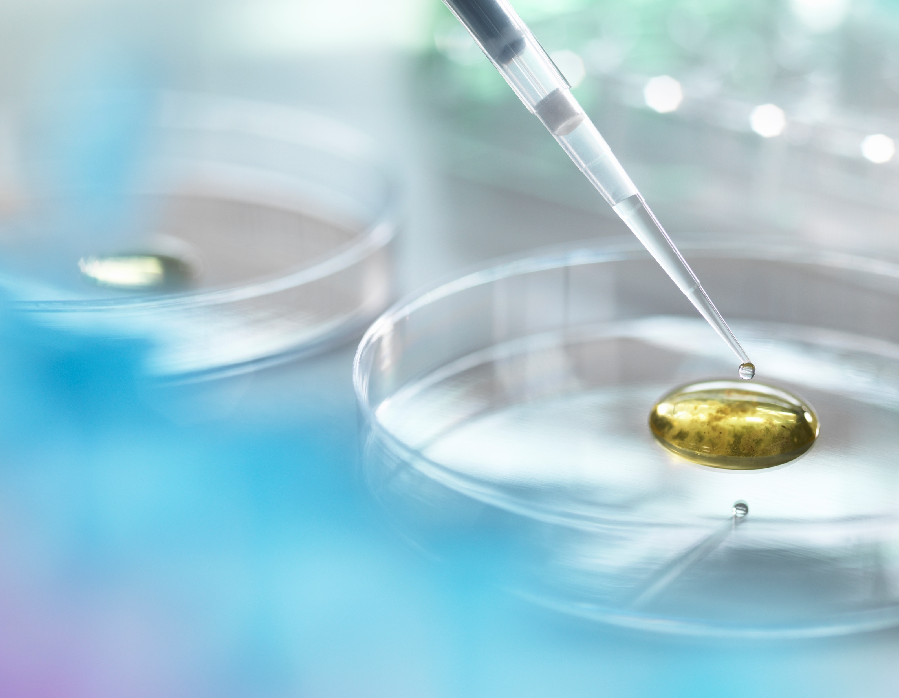
Covid-19 Vaccine Myths
Gwen Hau, Ba, RN, LSN
Nursing and Health Services
Cleveland Metropolitan School District
Gwen.hau@clevelandmetroschools.org

Slide 2
avoid THE PANDEMIC OF misinformation
The decision to immunize should be a well-informed, personal choice. It is imperative to seek trusted sources of information and ask “constructive questions” with an open mind.
Do Your Research
Trust Your Resources
Talk to a Healthcare Provider
Ask an Expert

Slide 3
COVID – 19 Vaccine Myths
I will get COVID-19 if I take the vaccine.
The vaccine contains no live virus, only mRNA. The symptoms people feel after receiving the vaccine are a normal part of their body’s own immune response and typical with any vaccine.
The vaccine will alter my DNA.
mRNA vaccines contain a very small but very specific piece of the virus’s genetic material. It will not interact with our DNA in any way.
mRNA never enters the nucleus of our cells, which is where our DNA (genetic material) is kept.
Cells of our immune system then break down and get rid of the RNA soon after it is finished using the instructions.
The vaccine will cause infertility.
The vaccine does not contain a live virus. There is no evidence that it increases the risk of infertility, still births or congenital defects.
We really don’t know what is in these vaccines.
Ingredient lists for the vaccines are readily available and can be found in all published studies.
We can’t trust the vaccine research because it was rushed.
While the technology may seem new, mRNA vaccine research has been ongoing since the 1990s.
The vaccine went through the same rigorous safety and efficacy testing as other vaccines as set forth by the FDA.
The research was funded through Operation Warp Speed to allow public and private entities to work together toward a common goal.

Slide 4
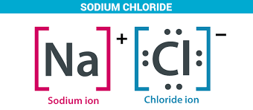
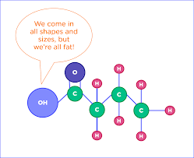
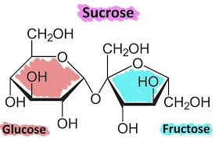
What is the COVID-19 vaccine made of?
mRNA
Small fragment of the genetic material of the spike protein of the SARS-COV-2 virus
Spike protein is how the virus attached to our cells
Lipids
“Greasy” coating that protect the mRNA and helps it “slide” into the cell
Examples: polyethyleneglycol (Miralax), cholesterol
Salts
Helps to protect against the acidity of our bodies
Examples: potassium chloride, sodium chloride
Acids and acid stabilizers
Help to maintain stability of the solution
Example: acetic acid
Sugar
Sucrose helps the molecules maintain their shape during freezing

Slide 6
Take home messages
While the timeline to bring the vaccine to the public was condensed, safety and efficacy were not sacrificed. Due diligence was still performed.
The mRNA vaccine technology is not new and was well studied long before the pandemic.
Many entities, including public and private companies, universities and research organizations,worked together toward this common goal.
The vaccine will not give you Covid-19, alter your DNA or cause infertility.
WE STILL NEED TO DO OUR PART AND STOP THE SPREAD.
Mask Up
Back Up
Wash Up
Stay Home, especially if you are sick!

Slide 7
GWEN HAU, BA, RN, LSN
EDUCATOR: NURSING AND HEALTH SERVICES
CLEVELAND METROPOLITAN SCHOOL DISTRICT
gwen.hau@clevelandmetroschools.org

